Slide 1
  Mitigating Data Privacy Risks from Artificial Intelligence
January 14, 2025
Presented by: Erin Illman and Ben Milam
®Bradley Arant Boult Cummings LLP

Slide 2

Agenda
Introduction and Overview of AI
AI Impacts and Understanding Risks
Effective and Ethical Approach to AI
AI Risk Management
Insurance Coverage for AI Risks

Slide 3
What is Artificial Intelligence?
No universally agreed upon definition of AI
Common elements across most systems --
Ability to think creatively
Ability to consider various possibilities
Ability to learn and apply learning
AI and Machine Learning
Common use of large data models
Different types of technology

Slide 4



What is Artificial Intelligence?
Technology Human Input Autonomy

Slide 5
General Use Cases
Recognition
Image, Speech, Facial
Examples:
Product matches (retailer)
Identification of defects in manufacturing
Plagiarism detection
Event Detection
Fraud detection
Cyber events and anomalies
Forecasting
Business forecasting (i.e. Uber/Lyft surge pricing)
Weather forecasting

Slide 6
General Use Cases
Personalization
Retail experiences that are customer based
Profile creation
Interaction Support
Chatbots
Smart Devices (Alexa/Siri)

Slide 7
General Use Cases
Recommendations
Based on predictive analysis
Health care diagnosis
Adjudicating certain cases (disability status)
Goal Driven Optimization
  Supply chain optimization (some forecasting)
  Driving routes/times

Slide 8
Risks Inherent in Artificial Intelligence
Type of AI Systems
  Artificial “Narrow” Intelligence
    Currently used widely
    Designed to perform a single or narrow set of related tasks
    May seem intelligent, but operates under narrow set of constraints
    “Broad” AI (i.e. autonomous driving) is more advanced but not “General” AI
  Artificial “General” Intelligence
    Closely mimics human intelligence
    Not currently in use commercially
  Artificial “Super” Intelligence
    Intellectual powers beyond humans across a broad range of categories
    Would be self-aware and understand human emotions
    Could experience reality similar to humans

Slide 9
Risks Inherent in Artificial Intelligence
How AI is Used
  Platform and available data
  Application and Purpose
  Infrastructure and hardware
  Model Type
  Use of Multiple AI Models (Stacking)
  Overlap with robotics or other technologies

Slide 10


Example: What are ChatGPT’s limitations?
Limitations
  Sometimes writes plausible-sounding but incorrect or nonsensical answers
  Known as “artificial intelligence hallucination”

Slide 11
Impacts of Artificial Intelligence
What are the potential harms?
  Individuals
    Bias
    Safety
    Rights and Opportunities
  Groups
    Discrimination
    Mass surveillance
    Harms to freedom of assembly or protest
  Society
    Harms to democratic process
    Disinformation “bubbles”
    Deep Fakes
    Autonomous weapons

Slide 12
Impacts of Artificial Intelligence
What are the potential harms?
  Companies/Institutions
    Reputational
    AI ethics and principles versus bottom line
    Legal and regulatory risks
  Ecosystem
    Environmental harms
      Agriculture
      Weather forecasting
      Energy consumption

Slide 13
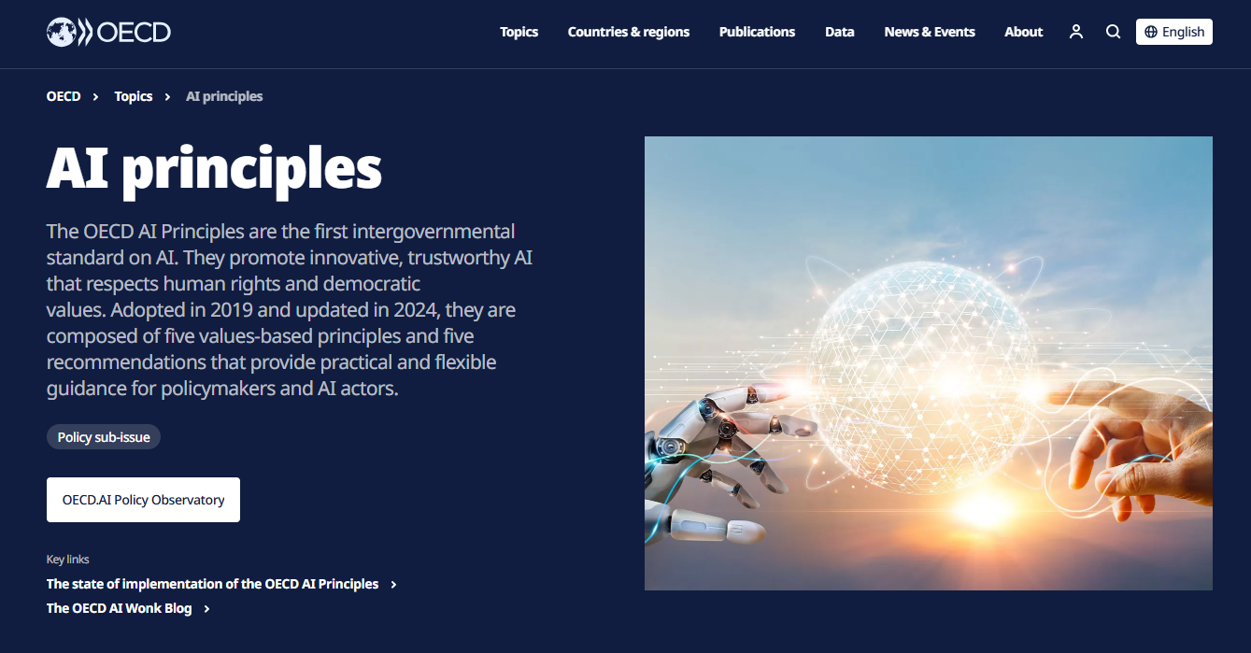
Effective and Ethical Approaches to
Artificial Intelligence
Organization for Economic Cooperation and Development
  Inclusivity
  Sustainable development
  Well-being and human rights
  Transparency and explain-ability
  Robust security and safety
  Accountability

Slide 14
Data Privacy Considerations
Legal requirements under privacy laws for automated data processing (i.e. use of sensitive information and opt-in/opt-out mechanisms)
Right to Privacy (Consent, Surveillance, Biometrics)
Data breach risks
Data persistence or repurposing or spillover
Data strategy
What data is required/needed?
How much data?
Is data identifiable?
Quality of data?

Slide 15
How to Address Privacy Issues
Privacy by Design
Are privacy professionals involved throughout the development lifecycle to help ensure the privacy rights of data subjects are respected?
Data Minimization vs. Statistical Accuracy
How can the organization balance regulations requiring data minimization while also achieving their desired level of statistical accuracy?
Notice & Consent
Have individuals explicitly consented to the use of their personal data – or is there a way for the individual to request to “opt-out”?
Data Retention
Once a model has been trained, is the underlying training data still required (i.e., Continuous Learning Models) or can it be deleted?
Data Deletion (‘Right to be Forgotten’)
Is the organization able to (1) identify an individual’s data after it has been ingested into a model, and (2) validate that both the original data – as well as any resulting impact or contribution derived from that data – are able to be deleted?

Slide 16
Risk Management for Artificial Intelligence
Understand the AI Development Lifecycle
7 Characteristics of Trustworthy AI
  Valid and reliable
  Secure and resilient
  Explainable and interpretable
  Privacy enhanced
  Fair, with harmful bias managed
  Accountable and transparent
Invest in AI Governance

Slide 17
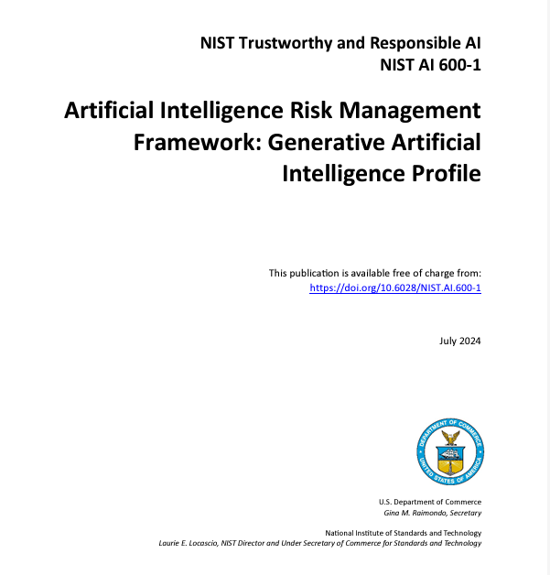

Risk Management for Artificial Intelligence

Slide 18
PREPARING FOR AND VETTING AI TOOLS
Consider internal use cases first
Ensure organization has mature information governance program
Cyber
Privacy
Litigation Readiness (Preservation, search, review)
Clean, understood data sets
Vendor and Product Review Process
Reach consensus on overall AI strategy and pilot/on-board protocols
Start considering AI evaluation (identify most important organizational factors)
Establish measurables and validation for technical specs
Commit to general and specific user training

Slide 19
INSURANCE coverage for data privacy risks

Slide 20

“A La Carte” Approach to Cyber and Data Privacy Insurance
First Party Coverage
Post Breach Response
  Crisis management
  Privacy notification
Time Element
  Business interruption
  Extra expense
Theft/Fraud
  Data assets
  Cyber extortion
  Computer fraud
  Funds transfer fraud
  Social engineering
Third Party Coverage
Information security and privacy liability
Regulatory defense and penalties
Payment card industry fines and assessments
Website media liability
Bodily injury and property damage
This Photo by Unknown Author is licensed under CC BY-NC-ND

Slide 21
First Party Loss
Breach response costs:
  Hiring forensic experts to secure your IT system and determine the cause of the data breach
  Engage legal counsel
  Breach notification to affected consumers and financial institutions
  Credit/identity monitoring
Property theft:
  Cost of recovering and restoring lost data
  Cyber extortion (i.e. ransomware) payments and costs
  Loss of funds from fraud
Business Interruption/Contingent Business Interruption

Slide 22
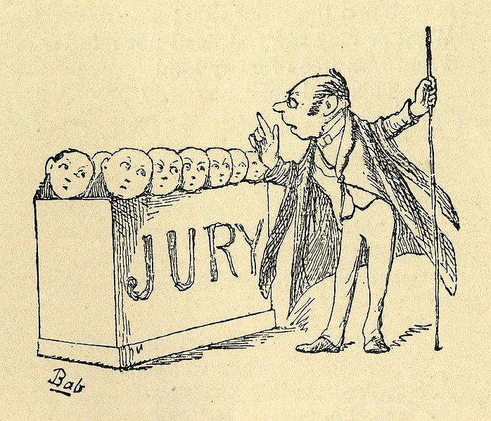
Third Party Liability
Civil liability to third parties, including:
  Loss, theft, or unauthorized disclosure of personal data
  Failure to timely disclose a data breach
  Use of insured’s computer systems in an attack on third party
Payment card industry fines and assessments for failure to comply with data security standards

Slide 23
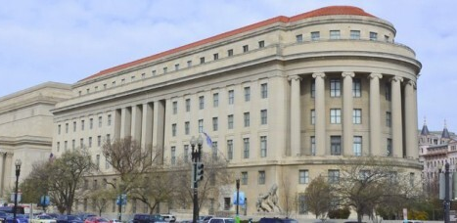
Regulatory Liability
Covers costs to respond to and defend regulatory investigations and proceedings
May cover regulatory fines and penalties
Especially valuable as insured may be dealing with multiple regulators in every jurisdiction with affected residents

Slide 24
How Will AI Change Cyber and Data Privacy Insurance?
Claims may increase in frequency and magnitude due to AI vulnerabilities, as well as use of AI tools by criminals
According to the Betterley Report, most insurers are not offering specific policy language for AI risks
No insurers reported exclusions for AI
Of 16 cyber and data privacy insurers surveyed, only one (Coalition) offered specific coverage wording for AI

Slide 25
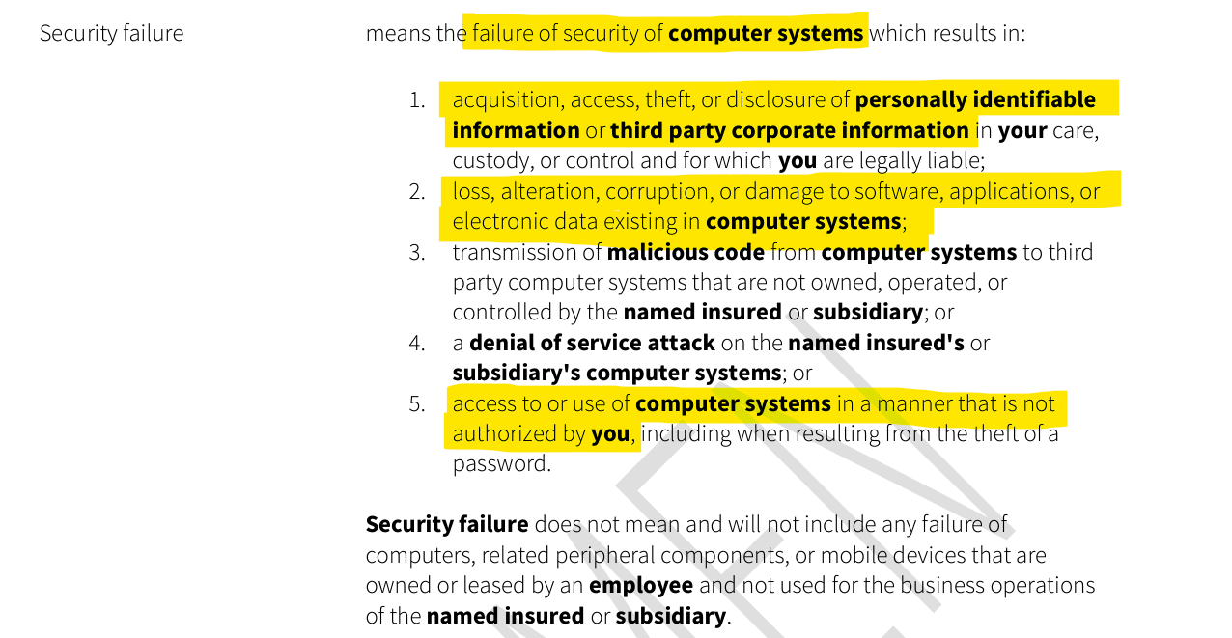
“Security Failure” Definition
(Without AI-Specific Language)

Slide 26
Impact on Professional Liability Insurance
Use of AI in professional services could blur lines between technology E&O and other types of professional liability
Traditional E&O may not apply to technology-powered services, and could exclude regulatory risk
New kinds of risks emerging that are not traditionally covered by technology E&O – e.g., bodily injury or property damage
Software developers may face increased litigation risk from consumers or third-party claims by customers

Slide 27
Allocation of Risk Between IT Vendor and its Customer
Insurance should follow the desired risk transfer
Party agrees to indemnity provision in its contract
Insurance is purchased to provide financial backstop for indemnity obligation
Business seeks indemnification from the indemnitor
Indemnitor tenders defense and liabilities to insurer
Unauthorized disclosure of personal info due to data breach
Injured party sues business
Business demands indemnity
Indemnitor tenders to insurer

Slide 28
Questions?

Slide 29
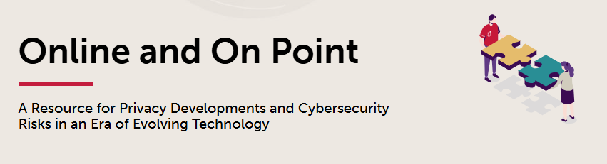
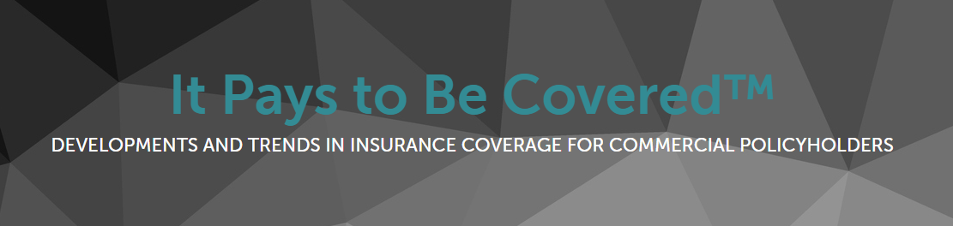
For Updates on Cybersecurity, Data Privacy, and Insurance Coverage
www.onlineandonpoint.com
www.itpaystobecovered.com

